Slide 1
Analog Electronics Lab (P-1) Experiment-1
Lab Instructors:
Ankita Dixit , E-mail:p20170414@pilani.bits-pilani.ac.in
Prem Sai Regalla, E-mail:p20190435@pilani.bits-pilani.ac.in

Slide 2
Common Emitter Configuration

Slide 3
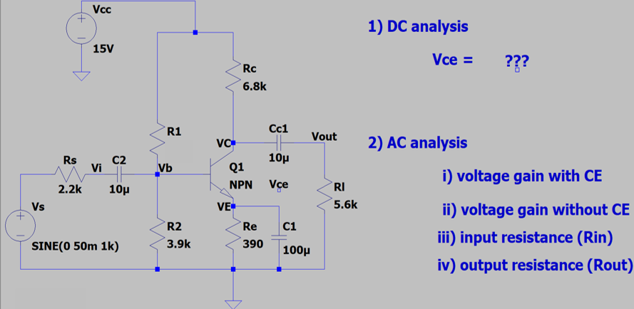
Circuit

Slide 4
Assignment:
Design the provided circuit on LT-Spice & calculate the parameters
Voltage gain (A_{v})
(a) with emitter capacitor
(b) without emitter capacitor
2) Input Resistance (R_{in})
3) Output Resistance (R_{out})
4) Show the waveform for input and output voltages
Submit the report in PDF format before 11 pm today to your assigned instructor.
Lab Instructors:
Ankita Dixit , E-mail:p20170414@pilani.bits-pilani.ac.in
Prem Sai Regalla, E-mail:p20190435@pilani.bits-pilani.ac.in

